Slide 1
House Rent Analysis (CDAC, ACTS – DBDA – SEPTEMBER 22)
Presented By :
Sagar Garg Mohit Bhilare
Vishal Singh Nikhil Joshi
Under The Guidance Of :
Mr. Sanjay Sane

Slide 2
Introduction
High demand for affordable housing, limited availability, and the need for data-driven decision-making by renters and landlords.
Houses are distributed across the city with different prices and amenities.
Hard to find a pattern by looking at the large data so need of visualization arises.

Slide 3
scope
CONVENTIONAL APPROACH
MODERN APPROACH
Difficult to analyze the large dataset, requires highly trained professionals
High possibility of errors
Time consuming process
ML Algorithms helps to analyze the large dataset and predicts the rent
Less possibility of errors
Less time consuming process

Slide 4
OBJECTIVE
To analyze the trends and patterns in House rent prices in Delhi region.
To build machine learning models that accurately predict house rent prices
To provide insights that can help inform decision-making by renters, landlords, and policymakers.

Slide 5
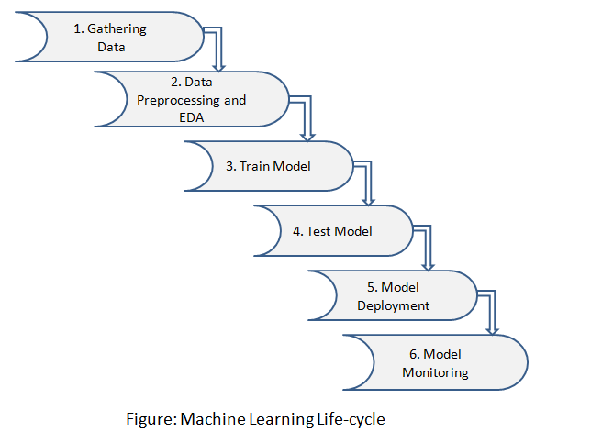
IMPLEMENTATION

Slide 6
Data understanding
Majorly comprises of three stages:
Data Ingestion and Extraction
Data Description
Exploratory Data Analysis

Slide 7
Data Ingestion & extraction
Used MongoDB to store the data.
Ingested data into MongoDB server from a CSV file.
Extracted data from MongoDB to use it for Model building
Extracted data from MongoDB in pandas data frame.

Slide 8
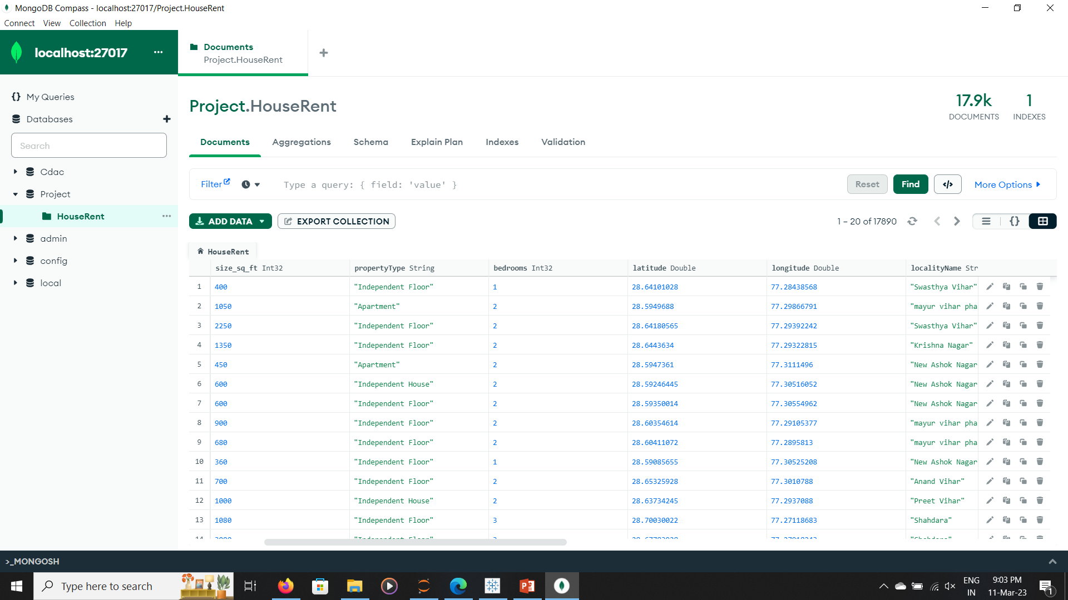
Mongodb compass

Slide 9
Data description
Delhi House Rent Dataset
Some of the features of Dataset are:
Size of property in sq. ft.
Property Type (Independent House, Apartment, Villa etc.)
Suburb/Region Name
Locality/Area Name
Approx. distance of House from Metro, Airport and AIIMS hospital.

Slide 10
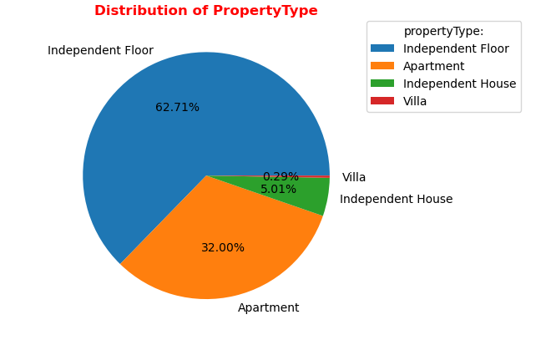
Exploratory data analysis

Slide 11
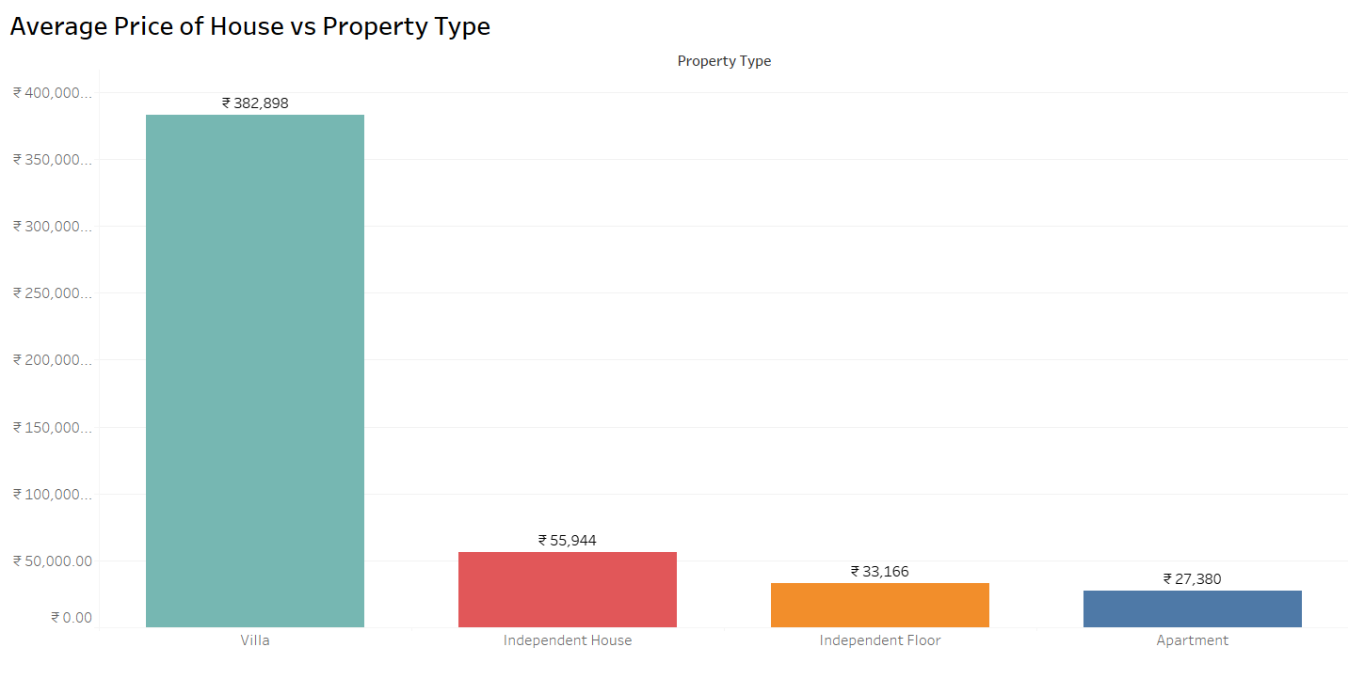
Exploratory data analysis

Slide 12
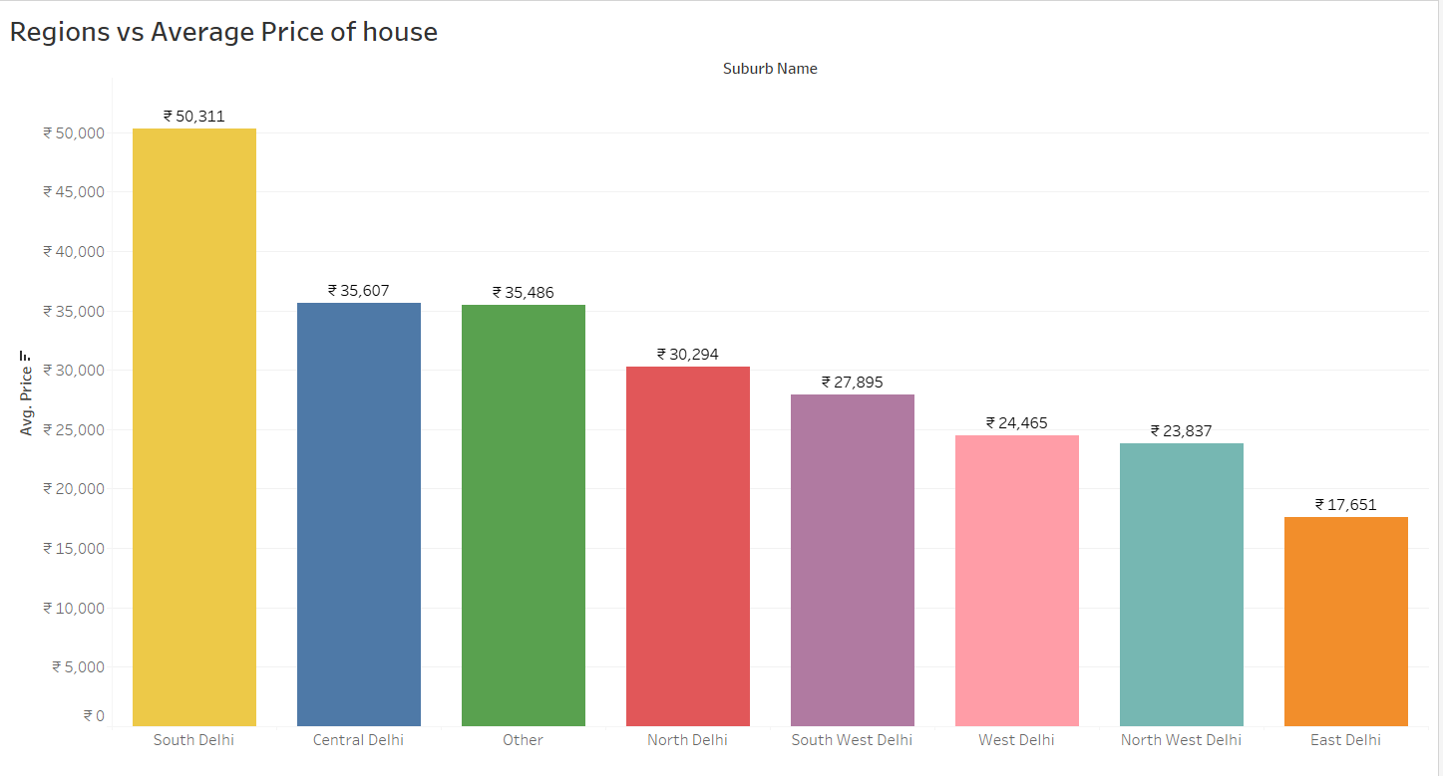
Exploratory data analysis

Slide 13
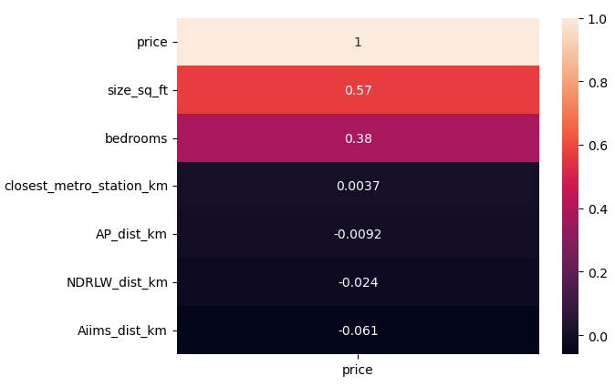
Exploratory data analysis
Correlation of Independent Features with Price

Slide 14
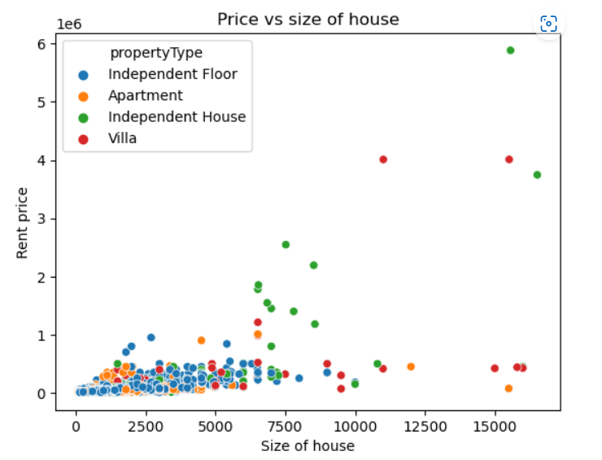
Exploratory data analysis
Scatterplot of House’s size and Price

Slide 15
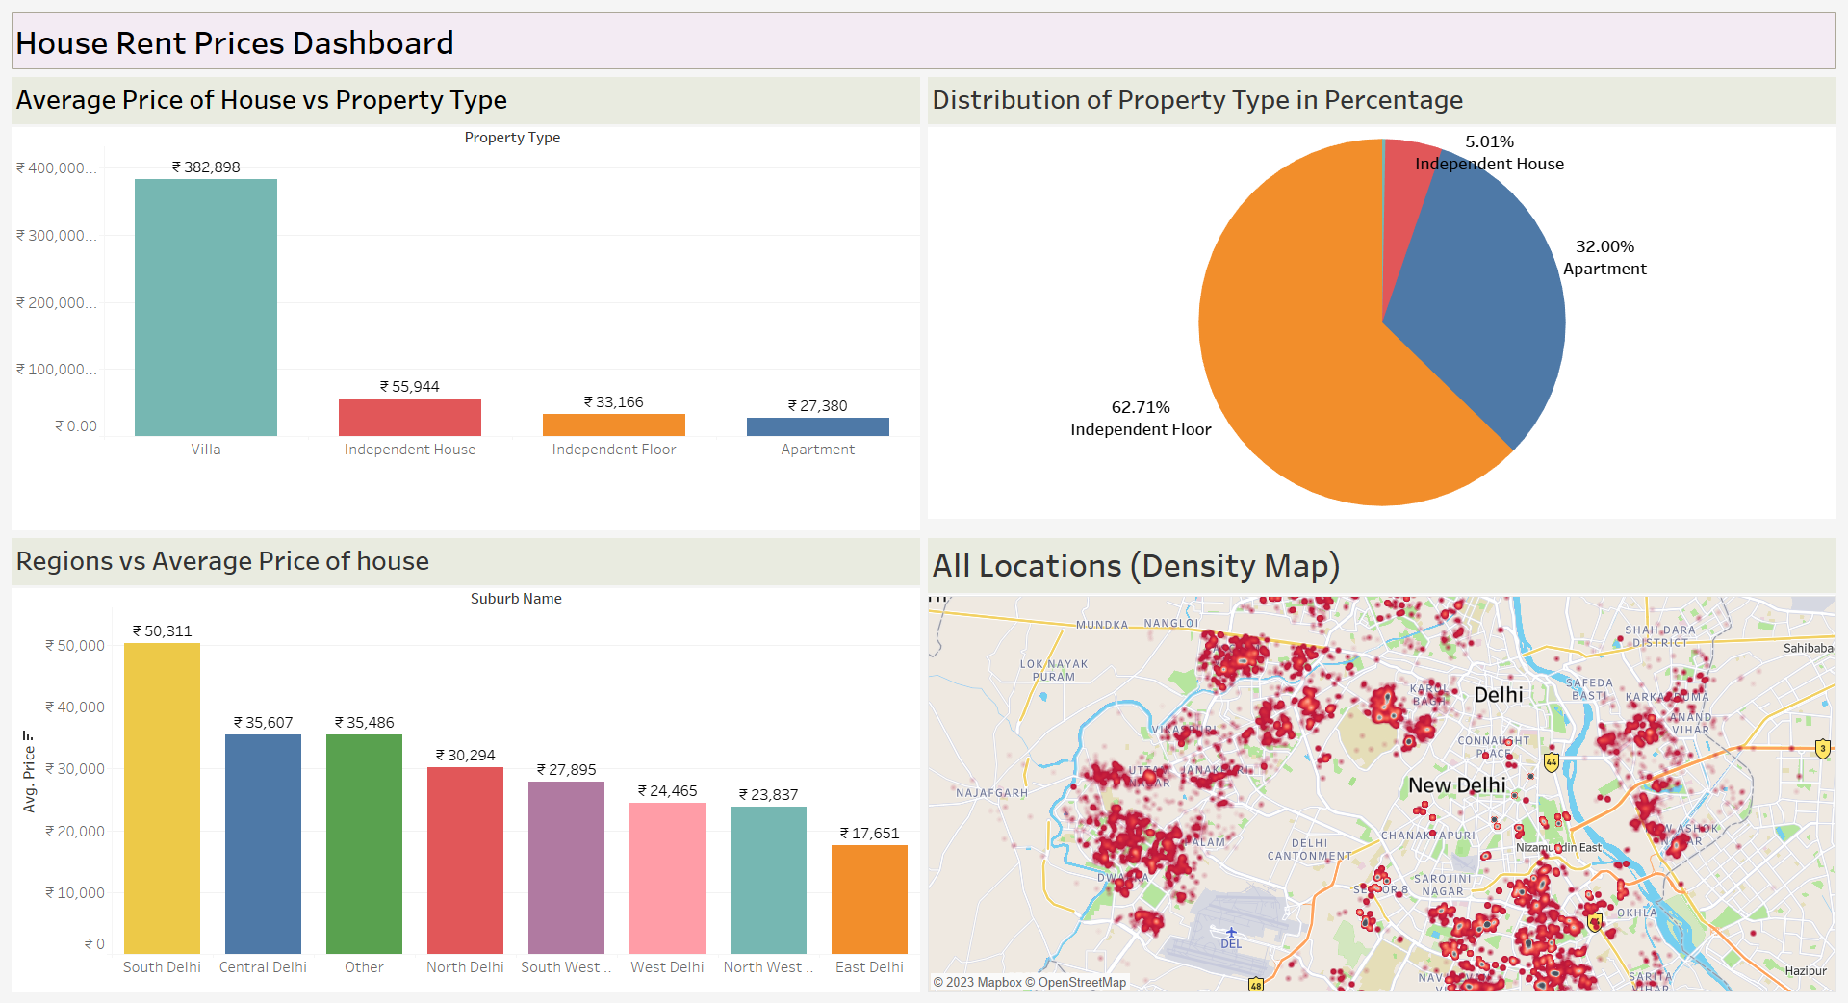
Tableau dashboard

Slide 16
Machine Learning Models
Trained and Tested various Machine Learning Algorithms to find the best suited one.
Some of those algorithms are:
Random Forest
CatBoost
Voting Regressor
Stacking Regressor
Decision Tree
KNN Regressor

Slide 17
Random forest
Parameters Tuned
Params = { 'max_features’:[5,10,15,20,30,35],
'n_estimators':[25,50,75,100,125]
}
R2 Score
0.9017881980216116

Slide 18
CAtBoost Regressor
Parameters Tuned
Params = {
'learning_rate': [0.1, 0.15, 0.3, 0.35, 0.4, 0.5,0.6],
'n_estimators': [25, 50, 75,85],
'max_depth':[2, 3, 4, 5,6,7,8,9]
}
R2 Score
0.8721512070469826

Slide 19
Voting Regressor
Parameters Tuned
Params = { 'DT__max_depth':[None,2,4],
'DT__min_samples_split':[2,5],
'DT__min_samples_leaf':[1,4],
'RF__max_features':[3,5,10],
'RF__n_estimators':[12,24]
}
R2 Score
0.8609555232547573

Slide 20
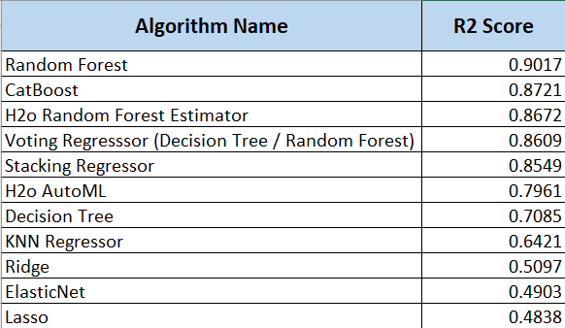
R2 Scores of Different ML Algorithms

Slide 21
Best model
Random Forest Regressor came out as best algorithm model for our dataset having the highest R2 score among all algorithms.
Prediction model was build using this Random Forest algorithm and application was deployed using Streamlit framework.
Link: https://house-rent-prediction.streamlit.app/

Slide 22
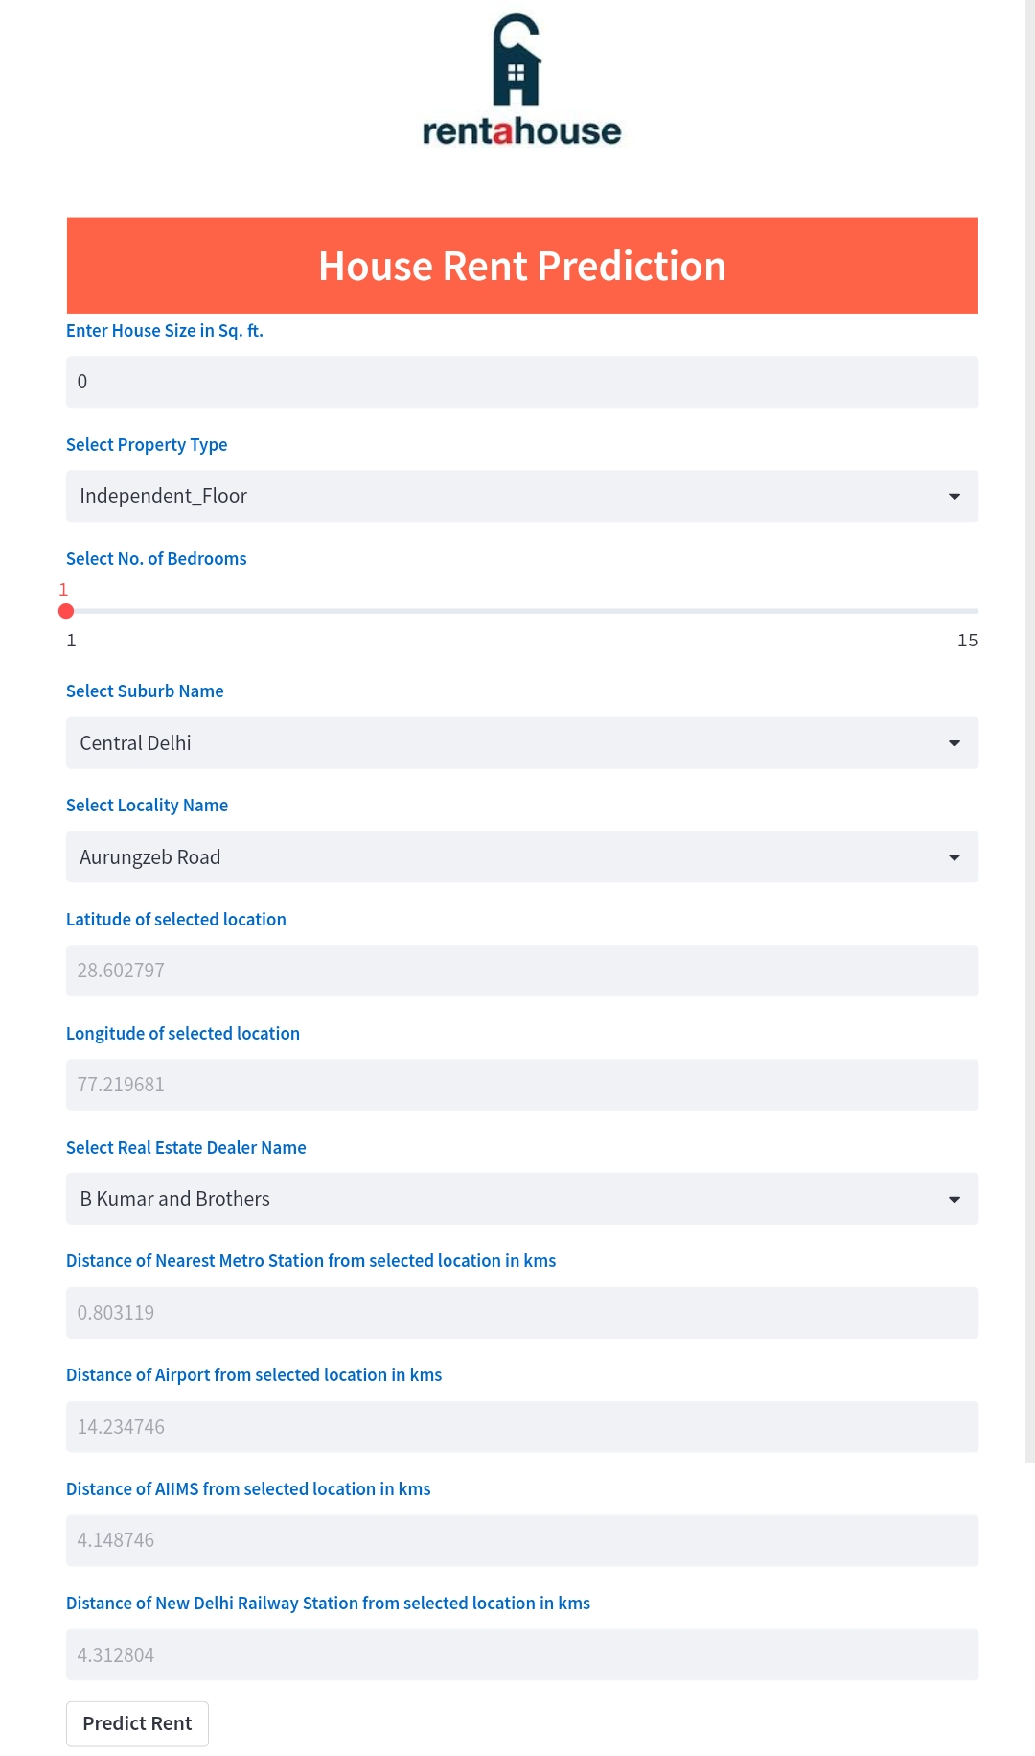
User interface

Slide 23
conclusion
Importance of the work: Can help renters make informed decisions about housing choices, help landlords optimize their pricing strategies, inform policymakers about trends in the rental market.
Future impact: Can help create more affordable housing, reduce housing inequality, and improve access to housing for all.
Limitations: Machine learning models with more data and higher computation power can be used to improve rent price prediction.

Slide 24
Thank you

